Slide 1
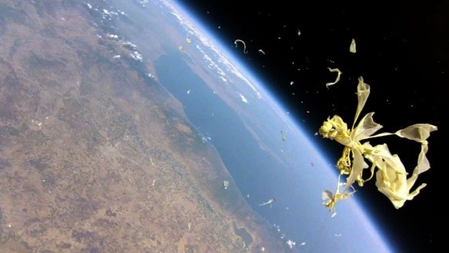


Intelligent Software Control for Nanosatellites
Interns: Matt Walls, Ahmed Diallo, Robert Lucci, Jason Craigg
Faculty Mentors: Dr. Shermane Austin, Prof. Michael Jiang

Slide 2
Outline
Software for controlling, tracking, and communicating with satellites is developed following the best practices and must be robust: the ability to tolerate and recover from the unexpected is necessary. Despite one’s best efforts to follow the best practices, it remains very risky to assume the software is free of faults. Autonomic Computing (AC), computing characteristics proposed by IBM, relies on the use of AI techniques to build computing systems with self-managing characteristics so that they are able to adapt to unpredictable changes while hiding intrinsic complexity to operators and users. An AC system makes decisions without assistance, using high-level policies. The system has sensors for self-monitoring, effectors for self-adjustment, and knowledge and planner adapters for exploiting policies based on self- and environment awareness.

Slide 3
Elements of Autonomic Computing
The system must be able to detect and protect itself from threats.
The system must be able to adapt to its environment.
The system must anticipate demand on resources.
The system must know its capabilities and limitations.
The system must be able to automatically configure and reconfigure itself.

Slide 4
Background
Developed in 1999 by Prof. Jordi Puig-Suari at California Polytechnic State University in San Luis Obispo, and Prof. Bob Twiggs at Stanford University’s Space Systems Development Library with the intention to provide a standard of micro and picosatellites.
Sizes range from 1U, 10cm cubes with scale factors for 2U to 6U (presently).
Low-cost, low-risk missions for education training, technology testing and scientific investigation – colleges and universities, federal agencies, e.g. NASA and DOD, and the Aerospace Industry.

Slide 5
Area of Application
CubeSats are satellites small in size but large in potential.
Examples of real-world application include:
High-altitude pictures
Radio communications
Atmospheric research and biology experiments
A test platform for future technology.

Slide 6
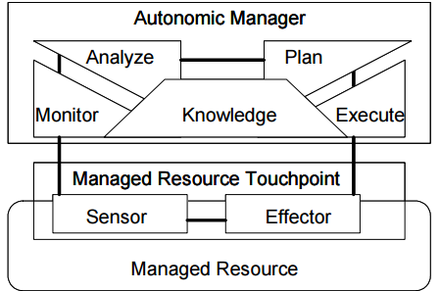
Autonomic Computing - Control Loop

Slide 7
Arduino UNO3
Arduino is an open source tool utilized for developing electronic devices. It includes a microcontroller board with writing software to create and test codes.
Arduino can be used to input data from sensors, control physical outputs, and communicate with computer software.
Notes:
ATmega16U2 on the left which controls the Serial interface and TTL links. On the right atmega328p is the powerhouse of the arduino. This controls the digital and analog pins all the sensors will be connected to.

Slide 8
Arduino UNO3
Microcontroller: ATmega328P
Clock Speed: 16 Mhz
Flash memory: 32 kB
SRAM: 2 kB
EEPROM: 1 kB
Operating Voltage: 5V
Digital I/O Pins: 14 (6 are PWM)
Analog Input Pins: 6
Notes:
ATmega16U2 on the left which controls the Serial interface and TTL links. On the right atmega328p is the powerhouse of the arduino. This controls the digital and analog pins all the sensors will be connected to.

Slide 9

Microcontroller: Arduino

Slide 10
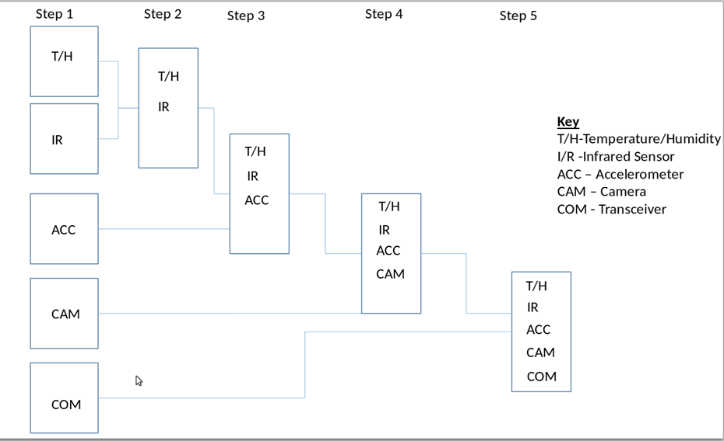
Integration Process
Notes:
ATmega16U2 on the left which controls the Serial interface and TTL links. On the right atmega328p is the powerhouse of the arduino. This controls the digital and analog pins all the sensors will be connected to.

Slide 11
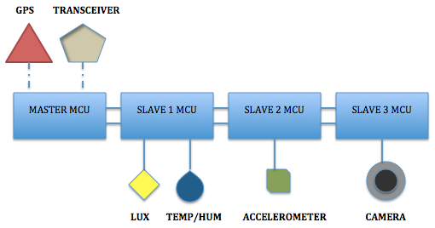
SIMPLE BALLOONSAT

Slide 12
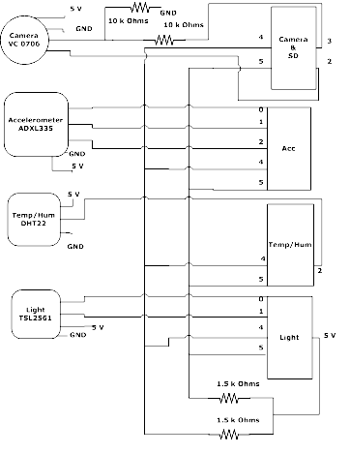
SCHEMATIC

Slide 13
SENSORS & COMPONENTS

Slide 14
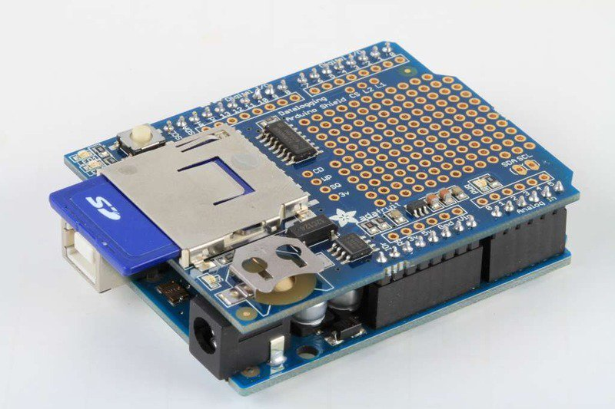
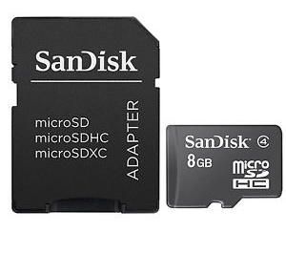
Data Shield & Micro-SD Card
It is an attachment for the Arduino that allows us to interface with an SD card and a real time clock without using up any pins. The Micro-SD Card is waterproof, shockproof, and X-ray proof. It can operate in temperatures ranging from -13 to 185 degrees Fahrenheit (-25 to 85 Celsius).

Slide 15
DHT22 Temp/Humidity Sensor
2.5mA max current draw
Data is collected every two seconds
Measures temperature (Fahrenheit and Celsius), and humidity.
Good for -40 to 257°F (-40 to 125°C) temperature readings
Good for 0-100% humidity readings with 2-5% margin of error
Notes:
This is what we use to collect data from the sensors. It’s used more for prototyping because data is send to an SD card. Thus, making it is easier to fix data problems during testing

Slide 16
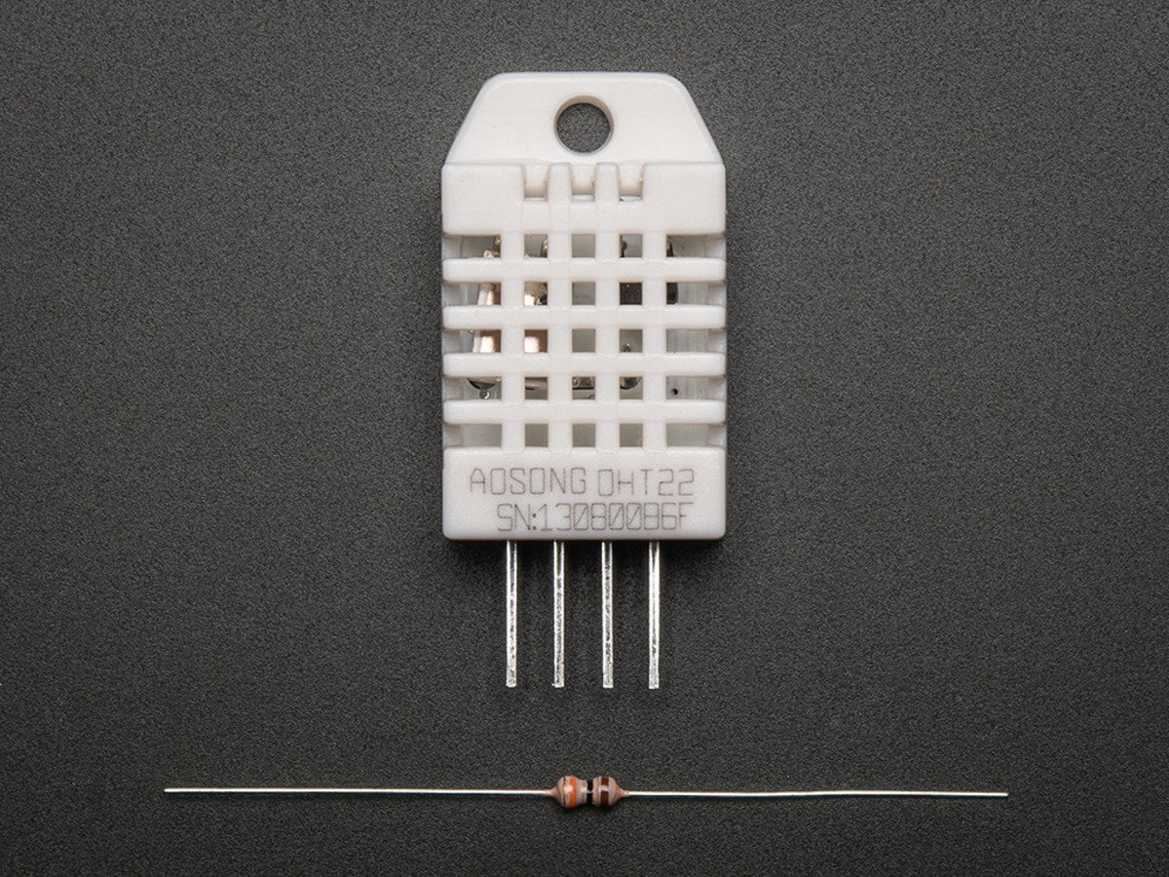
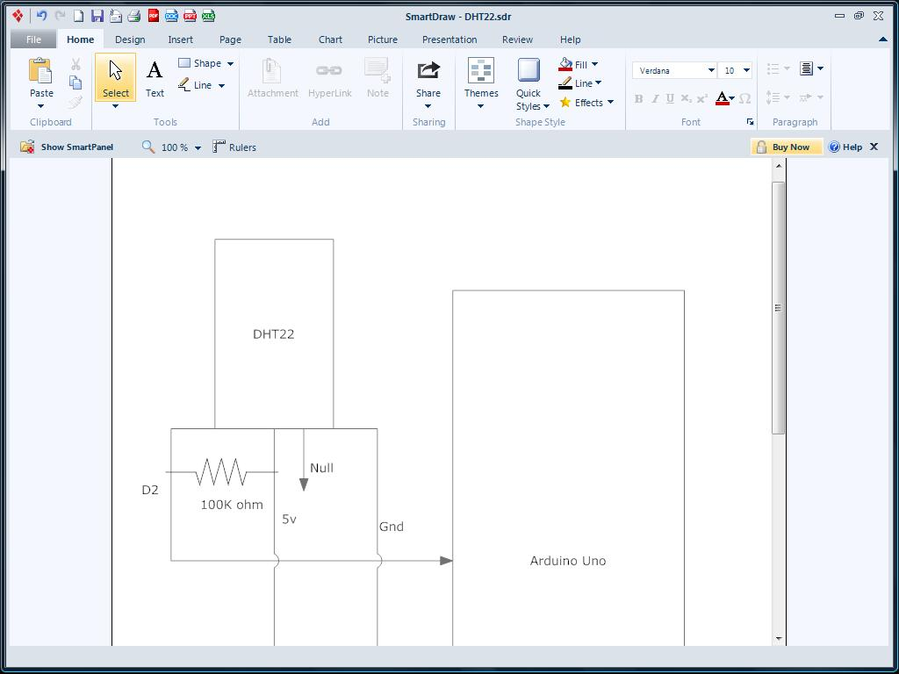
DHT22 Temp/Humidity Sensor
Pin1 – 5 volts
Pin2 – Data pin from the Digital pin 2 and a pull up resistor is used from the voltage
Pin4 – Ground pin
Notes:
This is what we use to collect data from the sensors. It’s used more for prototyping because data is send to an sd card. Thus, making it is easier to fix data problems during testing

Slide 17
Infrared Sensor TSL2561
Precisely measures illuminance in diverse
lighting conditions
Measures illuminance in lux
New data is recorded every 250 milliseconds
Interface: I2C
Operable temperature range: -22 to 176°F (-30 to 80 °C)
Dynamic range (Lux): 0.1 to 40,000 Lux
Wavelength range: 0.74 um - 1 mm

Slide 18
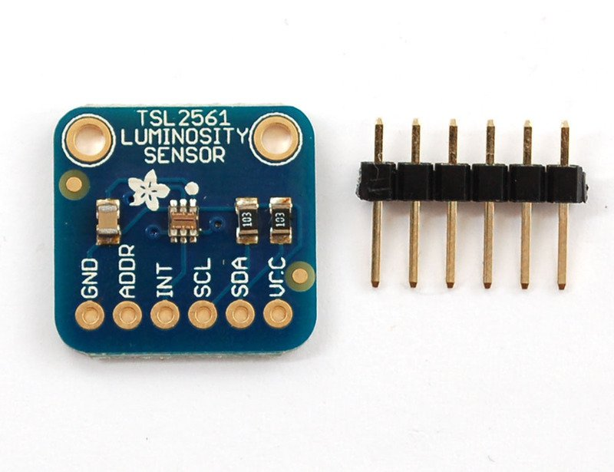
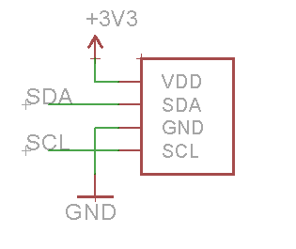
Infrared Sensor TSL2561
Vin – (Voltage in) takes in 3 volts
SDA – (Data pin) to analog #4
SCL – (Clock pin) to analog #5

Slide 19
ADX335 Accelerometer
It can measure the force of acceleration, whether caused by gravity or by movement.
A 3-axis accelerometer that measures the acceleration of gravity on the x, y, and z-axes.
The range of acceleration is -3g to +3g.

Slide 20
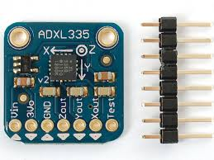
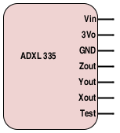
ADX335 Accelerometer
Vin – 5 volts GND – Ground
ZOut – Analog #1 YOut – Analog #2 XOut – Analog #3

Slide 21
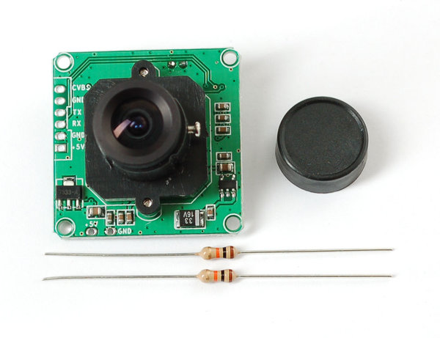
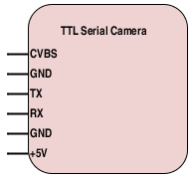
TTL JP Serial Camera VC0706
Uses 5 volts
Tx: connected to pin 1
Rx: connected to GND and pin 0
Second GND and CVBS connected to a RCA adapter
Notes:
This camera take snapshots, then it transmits them over the TTL serial link. It has manually adjustable focus, auto-white-balance, auto-brightness and auto-contrast.

Slide 22
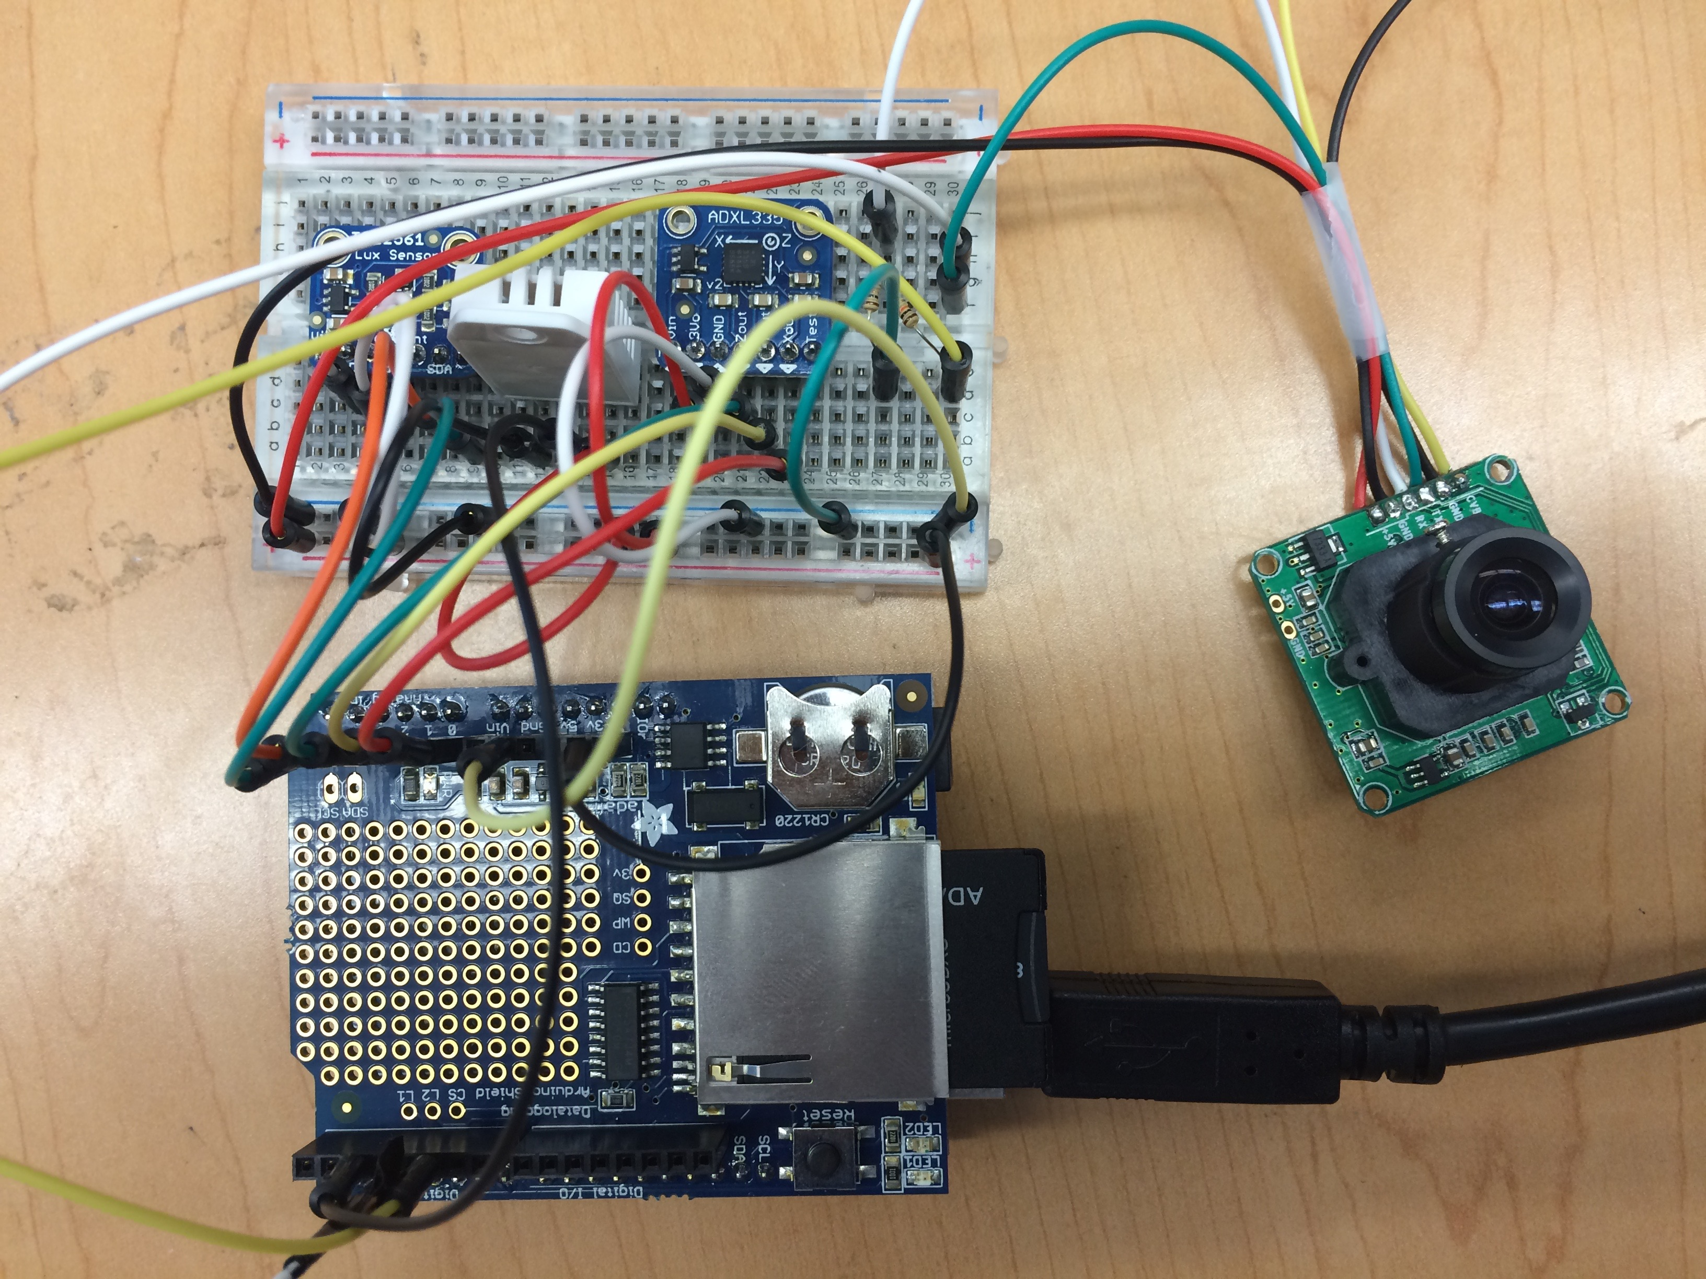
Integration of All Sensors

Slide 23
Step 4 Integration Issues
Memory Issues while using all the sensors in one single Arduino
Memory consumption too high with the camera
Pictures or Data missing
Still need to incorporate transceiver
The consensus was at the end to use 4 Arduinos board by using the Slave and Master setting. We spread the sensors and camera among the 3 Slave boards.
Notes:
At this stage of the integration process we face the issue of low memory with the Atmega-328. With of all the sensors and the camera on one single Arduino board, the memory consumption was initially at 95%. After improving the Sketch we were able to reduce the memory consumption to 75%, but still the camera would take memory consumption was still to high. We decided to spread the sensors and the camera between 4 Arduino board.

Slide 24
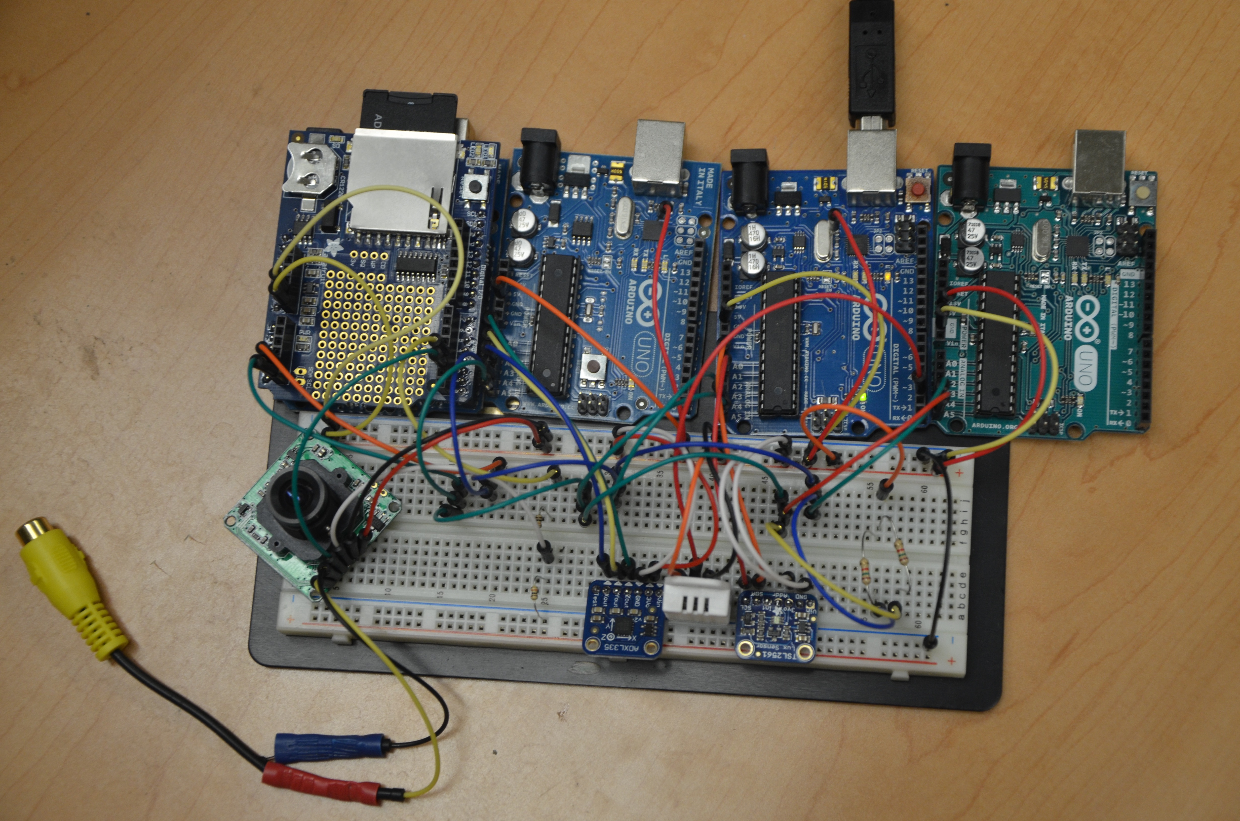
New Integration Process

Slide 25
Data Results

Slide 26
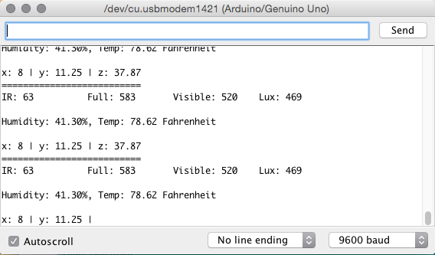
Snippet Result

Slide 27
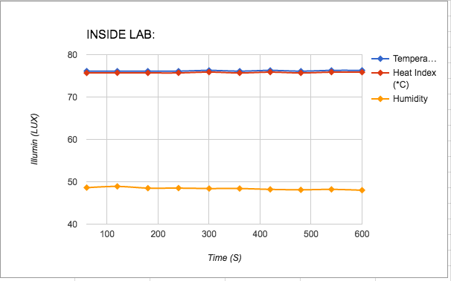
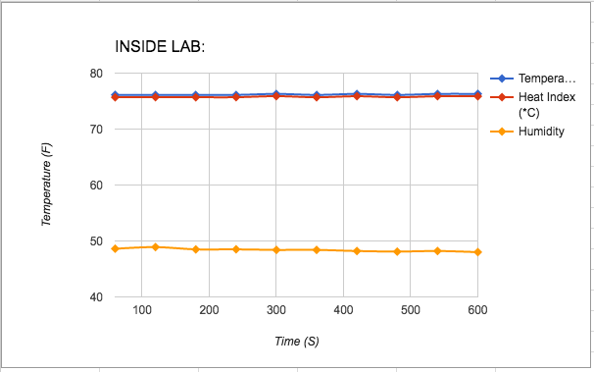
Data Temp/Hum Results

Slide 28
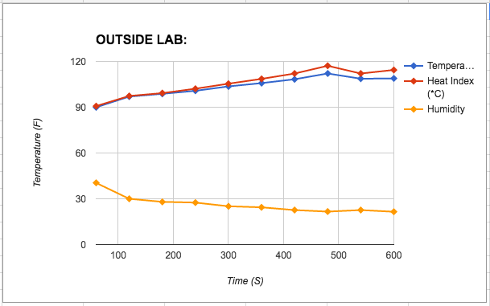
Data Temp/Hum Results

Slide 29
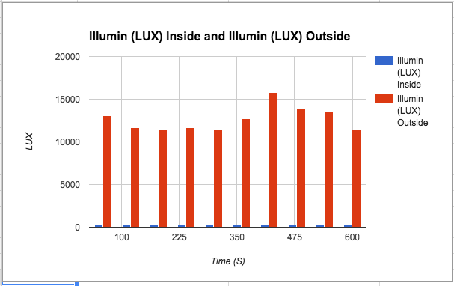
Data Light Results

Slide 30
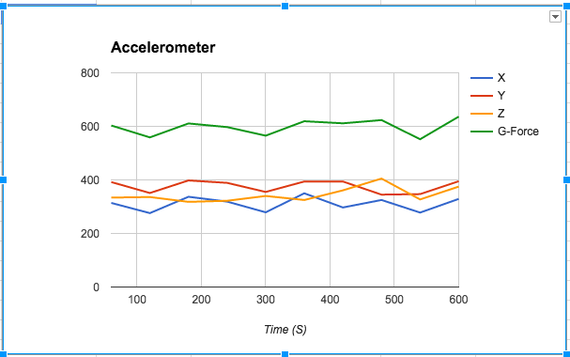
Data Accelerometer Results

Slide 31
What we learned
Arduino board and Sensors
How to successfully write and integrate code
How to setup and integrate hardware
What we need to do to create future Cubesat
We improved our collaboration techniques.
We gained valuable knowledge that would be useful for future endeavors.

Slide 32
Conclusion
Our objective for the summer was to design and implement a test system that would help us better understand issues related to microcontroller needs, interfaces, sensor requirements, memory storage, and power budgeting. The present system is based on Arduinos for learning and experimentation purposes, but later we will be doing microcontroller trades to determine best cases for the components and sensors. We started our CubeSat by assigning a sensor for each student. By specializing in our individual sensor, our next step was to integrate our sensors into a fully functional CubeSat. Once integrated we ran into low memory constraint. Our two prospective approaches were to try to simplify header file code or interface multiple Arduinos together, to essentially create a microcontroller network. The latter was the one we chose. The present system is not complete and will include a transceiver and a GPS for testing on a BalloonSAT. The final system will be basis for the development of AC policies for power management.

Slide 33
ACKNOWLEDGEMENT
NASA, New York City Research Initiative, New York NASA Space Grant Consortium, Goddard Institute for Space Studies, Goddard Space Flight Center Office of Education, and Medgar Evers College Department of Physical, Environmental and Computer Sciences who contributed greatly to this research project.

Slide 34
Questions?

